Slide 1
COMPLEXITY ANALYSIS

Slide 2
Analysis of Algorithms
Two ways to measure complexity:
Space Complexity – How much space does an Algorithm occupy in memory
Time Complexity – How much time does an Algorithm take to execute

Slide 3
Empirical ANALYIS
Experiment by running programs using various inputs and calculating elapsed time, it’s a reasonable measure of how efficient the algorithm is.
long startTime = System.currentTimeMillis();
/* Run the algorithm */
long end Time = System.currentTimeMillis();
long elapsedTime = endTime – startTime;
This is not a reliable way to measure algorithm efficiency. Why?

Slide 4
CHALLENGES
Experimental Method
Direct comparisons of running times of algorithms is difficult.
Dependent on Hardware and Software conditions
CPU must not run any other programs.
Run it on different inputs
Limited number of runs / input combinations
Record exact running times
Not feasible for an algorithm that takes a long time to execute
Fully code and implement an algorithm
Developing fully working systems in early stages is a waste of resources.

Slide 5
BEYOND EXPERIMENTAL ANALYSIS
Needs to be independent of hardware and software
Needs only a high level description of the algorithm instead of complete implementation
All possible input are taken in consideration
Developing an effective strategy by :
Count primitive Operations (memory access, mathematical operations, comparisons, method calls and returns, assignment operations)
Measure operations in terms of input size
Focus on the Worst-Case Input – if an algorithm is efficient with the worst possible input , it is effective. Designing with worst case inputs leads to better algorithms.

Slide 6
RAM Model of Computation
Assumptions to make before calculating complexity of Algorithms:
1. We have Infinite Memory
2. Each operations (Mathematical, Comparison, Assignment) takes one unit of time.
3. Each memory access takes one unit of time.
4. Data may be accessed from the RAM or the Disk, we assume that all data access is done from RAM.

Slide 7
ASYMPTOTIC ANALYSIS
Calculating the time the algorithm takes to execute based on the size of the input is called asymptotic analysis.
Size of input (n) -> Running time of algorithm
Small size of n -> Less running time
Bigger size of n -> More running time

Slide 8
Change in running time
Input size is increased -> Running time also increases
Input size is doubled -> Running time may double, triple, quadruple, increase 100 times even
Comparing algorithms based on how they perform when the input size increases can help us judge which algorithm is better.

Slide 9
Input Size | 2 | 4 | 10 | 100 | 1000 | 10000
Algorithm A | 2 | 4 | 20 | 200 | 2000 | 20 000
Algorithm B | 2 | 4 | 200 | 10 000 | 1 000 000 | 100 000 000
By observing how the running time increases based on increase in input size, we can determine which is a more efficient algorithm.
We calculate the rate of growth of algorithms, how the running grows with increasing input size.
We use BIG O notation to find the rate of growth of algorithms

Slide 10
Big O Notation
The most commonly used notation for complexity Analysis.
Big O notation categorizes functions based on their rate of growth.
Different functions that have the same rate of growth can be categorized under the same Big O category.
Growth rate of a function is called the Order of growth, hence Big O.

Slide 11
Big O – Formal definition
Consider a function f(n) , n being the input size.
Asymptotic behavior of f(n) is how fast f(n) grows as n become large.
f(n) is O(g(n)) if there exists constant c and n₀ , such that
f(n)<= c g(n) for all n>=n₀

Slide 12
Consider g(n) = 5n+4 and f(n) = n
There should be some constant c and n₀, such that
5n +4 <= c n for all n>=n₀
When c= 6 and n₀=4, 5n+4 < = 6n for all n>=4
We can say that g(n)=5n+4 belongs to O(f(n)), where f(n) = n.
In other words, g(n) is O(n)

Slide 13
The combination of c and n0 may be infinite, we only have to prove one instance of c and n₀ which holds true.
There is no necessity to find the first ever or the best combination of c and n₀.

Slide 14
COMMON ASYMPTOTIC FUNCTIONS
F(n) is only represented by some simple functional forms.
These forms contain a single term in n with a co-efficient of 1.
F(n) = c , constant rate of growth
F(n) = log_{b}n, b>1 , Logarithmic functions
F(n)= n , Linear Functions
F(n)= n log n
F(n) = n² , Quadratic Function – occurs commonly with nested loops
F(n) = 2^{n} , Exponential Function, loop operations double every iteration
F(n) = n! , Factorial

Slide 15
Comparing Growth Rates
Value of n | log n | n | nlogn | n² | n³ | 2^{n}
1 | 0 | 1 | 0 | 1 | 1 | 2
2 | 1 | 2 | 2 | 4 | 8 | 4
4 | 2 | 4 | 8 | 16 | 64 | 16
8 | 3 | 8 | 24 | 64 | 512 | 256
16 | 4 | 16 | 64 | 256 | 4096 | 65536
32 | 5 | 32 | 160 | 1024 | 32768 | 4.29E+09
64 | 6 | 64 | 384 | 4096 | 262144 | 1.84E+19

Slide 16
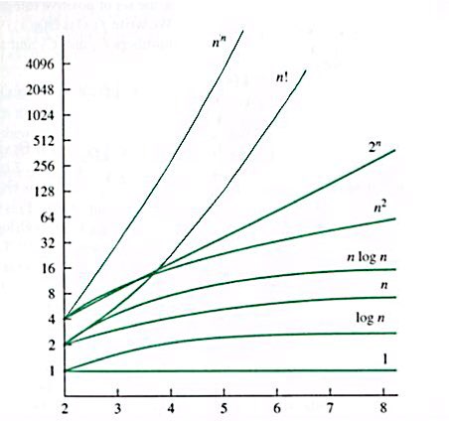
F(n)
n

Slide 17
Slowest to Fastest growing functions
1
log n
n
n log n
n²
n³
…
n^{k}
2^{n}
3^{n}
…
k^{n}
n!
Slowest growing function
Fastest growing function

Slide 18
Rules of finding Big O
Given any function F(n) , the following are the rules to finding Big O:
Always consider the fastest growing term of n
Ignore all coefficients
If f(n) is a constant , according to rule 2 f(n) belongs to O(1)
Base of the log is not important

Slide 19
Loose & Tight Upperbounds
5n+4 can also belong to O(n²), this is called the loose upper bound. All loose upper bounds are correct.
f(n) must belong O(n^{m}) where m is the highest power of n in the function, this is called a tight upper bound.
g(n) is the smallest possible function to satisfy the Big O definition.

Slide 20
Additional READING:
Logarithmic Rules
Goodrich , Chapter 4 , Proposition 4.1
Summation Formulae
Goodrich, Chapter 4, Page 149
Exponent Rules
Goodrich, Chapter 4, Proposition 4.4
Properties of Big O, Chapter 4 , Example 4.7 to Example 4.13

